Slide 1

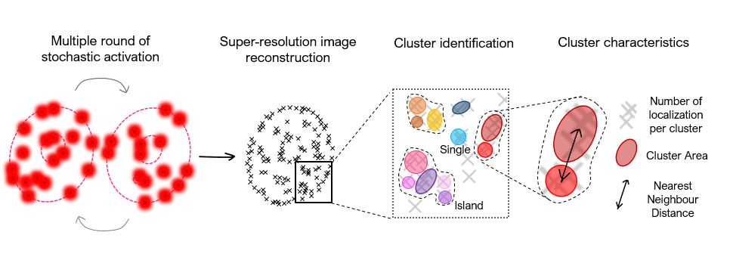
CLUSTER ANALYSIS
Visual instructions by Laura Martin, February 2022 1st 2022
STORM microscopy and cluster analysis for PcG studies
Laura Martin, Álvaro Castells-García, Maria Pia Cosma, and Maria Victoria Neguembor

Slide 2
CLUSTER ANALYSIS
Cluster Analysis is used to identify regions of high density of signals in super resolution images taken with STORM
In STORM, molecules of interest are labelled with fluorophores and imaged.
The light signal of the fluorophores is registered as a list of “localizations”
Localizations are the coordinates x,y (and z if performed in 3D) of the light signal in the field imaged.
Localizations info is stored in .bin files.
We give these .bin files to the CLUSTER_ANALYSIS_Main.m matlab code (formed by several functions).
The code will finally identify bigger and smaller high density regions, called Islands and Clusters, respectively.

Slide 3
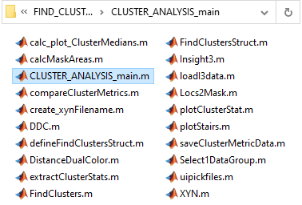
CLUSTER ANALYSIS
Original script from Carlo Manzo
Modified in the years by J Otterstorm, J Borbely, A Castells, & L Martin
20 functions

Slide 4

CLUSTER ANALYSIS
Hierarchical code organization of main functions
For detailed organization see ___Informtion about CLUSTER_code.docx
Saves output files
(.xyn, .mat, .bin, .dcc, .fig, .png)
>CLUSTER_ANALYSIS_main
Set analysis parameters
>defineClustersStruct
>FindClusterStruct
>FindClusters
>saveClusterMetricData
>extractClusterStats
>DistanceDualColor
Identifies Islands and clusters
Calculates clusters’ features:
n° localizations
Areas
NND (of In-Island only)
Calculates the global NND
between ALL clusters

Slide 5
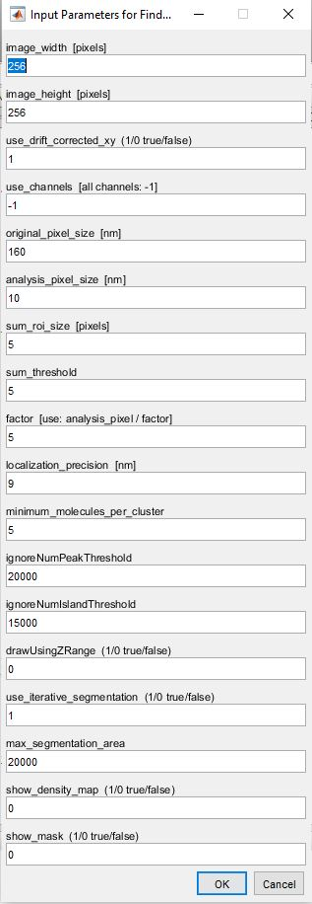
CLUSTER ANALYSIS
Cluster Analysis requires the input of several parameters that can affect deeply the process of Islands and Clusters identification

Slide 6
CLUSTER ANALYSIS
Values depending on Microscope/Camera settings
CRUCIAL FOR CLUSTER ANALYSIS
Optionals
Computational settings
Options for 3D images
Extra optional plots

Slide 7
CLUSTER ANALYSIS
HOW DOES THE CODE WORK?

Slide 8
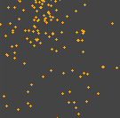
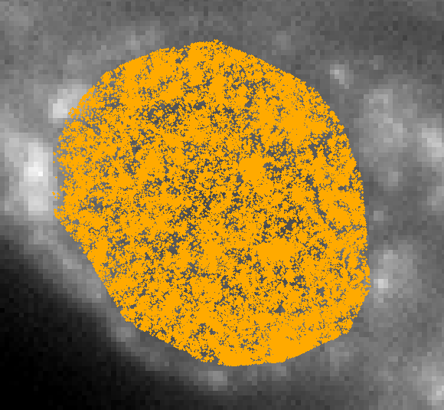
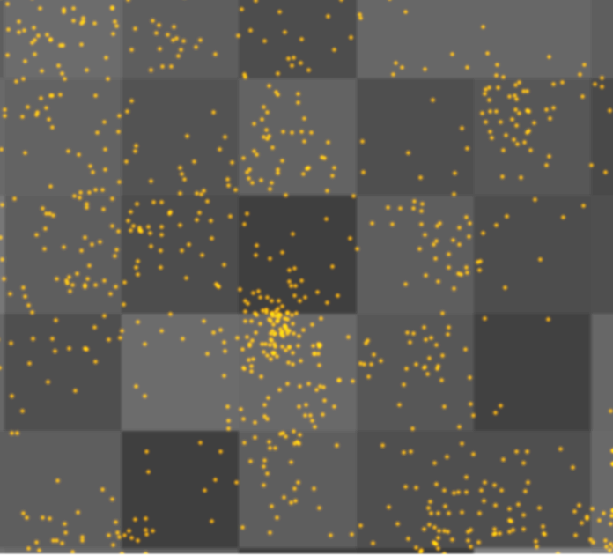
CLUSTER ANALYSIS
.bin file of localizations
First of all we have to define the size and resolution of our .bin file of localizations
In general, it is 256x256 px, 1px=160nmx160nm
160nm
1
pixel

Slide 9

CLUSTER ANALYSIS
10 nm
Before starting the cluster analysis, we enlarge the image of a zoom factor= original/analysis px_size
In this example, the zoom is 16X.
The pixel are now smaller,
measuring only 10nm x 10nm.

Slide 10
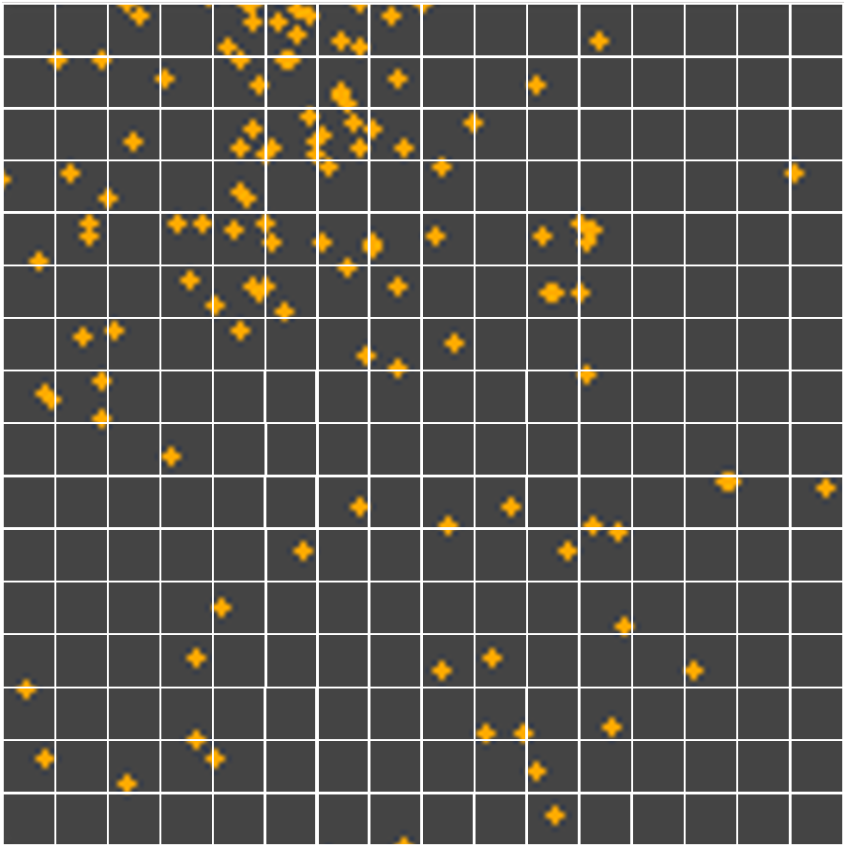
CLUSTER ANALYSIS
2
1
2
1
1
3
4
2
2
32
2
2
1
2
1
4
1
We now create a density map based on local density of localizations.
To do this, we have to define the extent of the region considered as “local”.
In this example, we define it as the area of 5px x 5px surrounding each pixel. In this area, we count the number of localizations, we sum them, and we assign the number to the central pixel.
We repeat the procedure for each pixel.
We will have a matrix of size 4096 x 4096
[256 px x16 zoom factor = 4096 x 4096 pixels (each of 10nm)]
The values of the matrix are the sum of localizations around each pixel.
1
4
1
1
1

Slide 11
CLUSTER ANALYSIS
2
1
2
1
1
3
4
2
2
32
2
2
1
2
1
4
1
1
4
1
1
1
We will have regions of HIGH density and regions of LOW density

Slide 12
CLUSTER ANALYSIS
ISLAND
After summing localizations, we have to discriminate between high and low density. For this, we set a threshold.
If the value of a pixel is now below that threshold (i.e. <5), that pixel is discarded from the cluster analysis
2
1
2
1
1
3
4
2
2
32
2
2
1
2
1
4
1
1
4
1
1
1
Empty
region

Slide 13
CLUSTER ANALYSIS
10 nm
After the threshold, a binary mask is created.
Pixels becomes 0 and 1.
-0 pixel are discarded.
-1 pixels (=mask)are kept and analysed.
The localizations inside the pixels discarded (low density), are discarded forever.
The filtered localizations, belonging to pixels kept, will be analysed to identify:
ISLANDs
CLUSTERs

Slide 14
CLUSTER ANALYSIS
10 nm
ISLANDs
Are regions of the cell
with high density of localizations.
CLUSTERs
Are small regions with HIGH local density of localizations inside an ISLAND

Slide 15
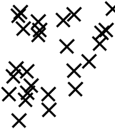
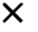


CLUSTER ANALYSIS
ISLANDs are defined first.
Inside ISLANDs we look for CLUSTERs
Super-resolution image
reconstruction
Cluster identification
ISLANDs
$$n° cluster>1$$
$$n° cluster =1$$
Inside ISLANDs we have n CLUSTERs.
They are called CLUSTERs InISLAND
Inside ISLANDs we only have 1 cluster, thus this island is not called ‘island’ anymore, but becomes a
SINGLE CLUSTER
(=ISLAND with only 1 cluster)
SINGLE
Cluster
CLUSTER
InIsland

Slide 16
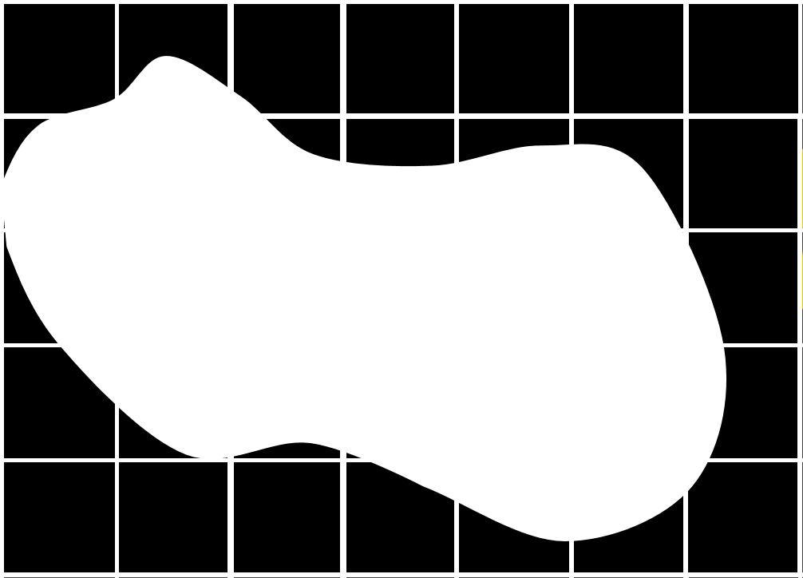
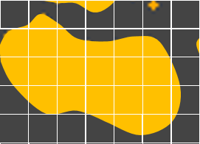
CLUSTER ANALYSIS
10 nm
For ISLANDs identification:
From the binary mask of 0 and 1 pixels, the fuction Regionprops
automatically identifies regions separated from other, that we call “Islands”.

Slide 17
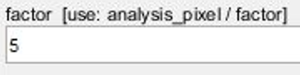
CLUSTER ANALYSIS
The code than analyses Island by Island.
It picks one Island and resizes it of a factor (i.e. 5X).
10 nm : 5 = 2 nm
10 nm
2 nm

Slide 18
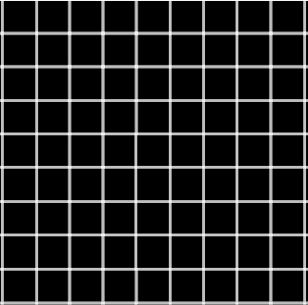
CLUSTER ANALYSIS
10 nm
2 nm
The code looks for the localizations that stand inside the mask of the Island.

Slide 19
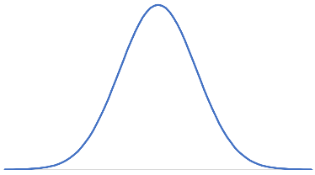
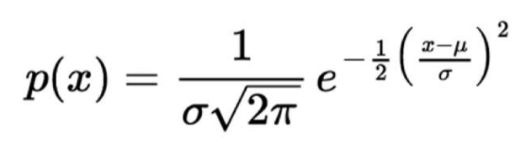
CLUSTER ANALYSIS
To each localization:
The code associates a Gaussian curve

Slide 20
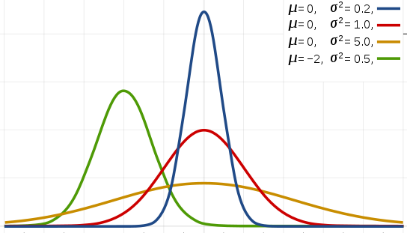
CLUSTER ANALYSIS
The shape of the Gaussian assigned is defined by the σ, according to the following formula:
loc precision (9nm)
σ =
new analysis px (2nm)

Slide 21

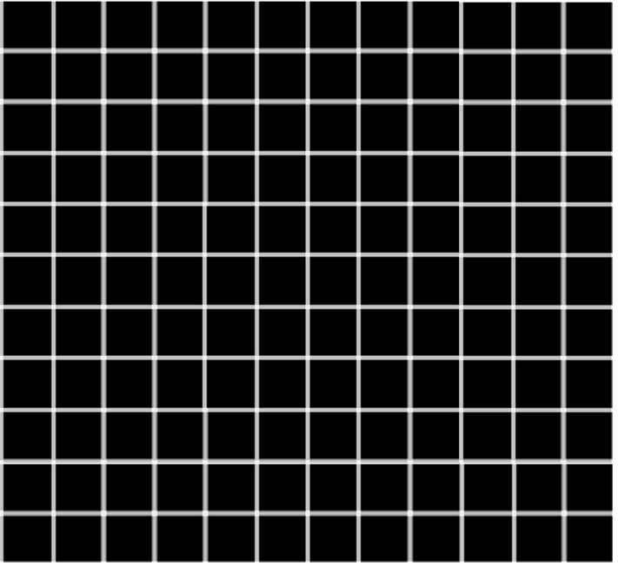
CLUSTER ANALYSIS
The Gaussian is centered in the localization x,y coordinates, and extends in a squared ROI of dimension:
roi size = 2*(numSigma*σ)
By default, in the code, the numSigma is 3.
3σ
.1
.1
.1
.1
.1
.35
.35
.35
.1
.1
.1
.5
.1
.35
.35
.1
.35
.1
.35
.35
.1
.1
.1
.1
.1
x, y localization coordinates

Slide 22
CLUSTER ANALYSIS
The code associates the Gaussian curve values to every localization.
.1
.1
.1
.1
.1
The values of different Gaussians are summed together when overlapping
This generates a density map
.35
.35
.35
.1
.1
.1
.5
.1
.35
.35
.1
.45
.1
.2
.35
.1
.1
.35
.35
.35
.45
.1
.2
.1
.1
.1
.1
.5
.1
.35
.35
.1
.35
.1
.35
.35
New matrix of the summation of Gaussian values belonging to localizations
.1
.1
.1
.1
.1

Slide 23
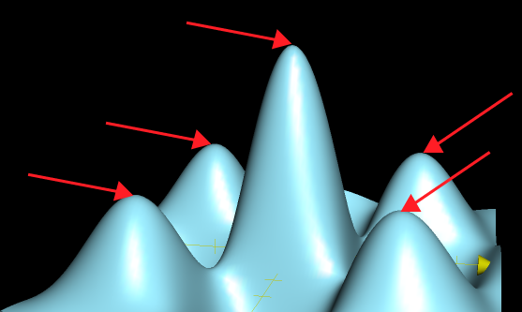
CLUSTER ANALYSIS
The code wants to find the local maxima.
To do this, the code kind of “scans” in 9 rounds the Gaussians according to their max intensity.
100%
1) It finds the Max value of the whole Island, and its coordinates.
MAX
80%
2) It ‘cuts’ the peaks at 90% of the Max, and finds the coordinates.
50%
20%
3) It ‘cuts’ at 80% and repeat again also for 70%, 60%, 50%, 40%, 30%, 20%, 10%
The coordinates found are the CENTROIDs of the CLUSTERs.

Slide 24
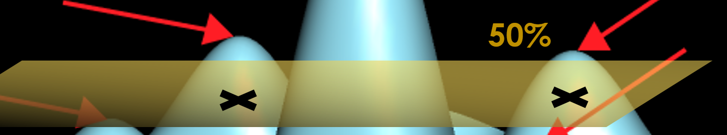
CLUSTER ANALYSIS
At each section (90%, 80%... etc.) the values kept are binarized into a black and white mask.
The function regionprops identifies the Clusters from the mask.
The function regionprops.Centroids finds the coordinates of the Centroids of the Clusters found.
N.B. In each round, the Centroid already found is “stored” and not recalculated anymore, to avoid the risk of losing it afterwards.
Then, the function lik_sig retrieves the list of filtered localizations belonging to the Cluster.

Slide 25
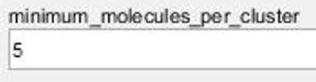
CLUSTER ANALYSIS
In each Cluster, the code counts the Number of Localizations.
If the Number of localizations belonging to each Cluster is
≥ minimum_molecules_per_cluster
the cluster is confirmed.
Clusters with Number of localizations < minimum_molecules_per_cluster are discarded.

Slide 26
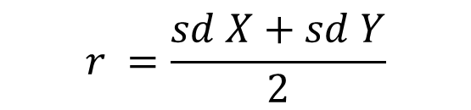

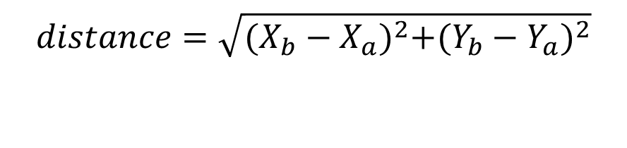
CLUSTER ANALYSIS
Of the filtered Clusters kept in the analysis, the code calculates:
-the coordinates of the Centroid of each Cluster, as the mean of cluster’s localizations coordinates
-the area (nm^2) of each Cluster, as the mean of cluster’s localizations coordinates
To convert px to nm, simply *160 (original pixel size)
$$r =\frac{sd X+sd Y}{2}$$
$$A=πr^{2}$$
-the Nearest Neighbour Distance (NND) in nm between pairs of closest Clusters, as the mean of cluster’s localizations coordinates
$$distance=\sqrt{{(X_{b}−X_{a})}^{2}+{(Y_{b}−Y_{a})}^{2}}$$

Slide 27
CLUSTER ANALYSIS
N.B.
The calculation of NNDs is done separately for InIslands clusters and for “Single” clusters (=Islands with only 1 cluster inside).
The FindCluster.m calculates the NND of InIsland clusters only. For Single clusters, NND is defined as ‘Infinite’ since for definition they have no close neighbours.
To measure the NND of also Single clusters, the code calls the function DistanceDualColor.m. (explained in the next slide).
The results of NND are put together in the .xyn output files (13rd column of the table).

